Slide 1
SCORING HIGH SCHOOL VOLLEYBALL
By Keith Melchior - Baltimore Board of Officials for Women’s Sports – August 2023

Slide 2
SCORING CLINIC PREFACE
This PowerPoint presentation is to help scorers understand proper NFHS scoring procedures. All officials NEED to know the correct way to score a match. Bad scorekeeping can be a nightmare to figure out. Rest assured, it will happen when you least expect it and you need to be prepared. Bottom line: Know and understand HOW to score a match.
Every activity in a volleyball match is considered an event. Serving, points, substitutions, side-outs, re-serves, replays, cards, time-outs. The comments is for explanations of cards or anything else that should be documented.
When a team is serving, you need to record all the events that take place during that player’s term of service. The text pages on this presentation describe all the events that happened during the set. You need to make the correct entries on the scoresheet.
A sample scoresheet on the subsequent slides will show the correct way it should have been written using RED INK.
The next page shows a blank scoresheet like the one in front of you.

Slide 3
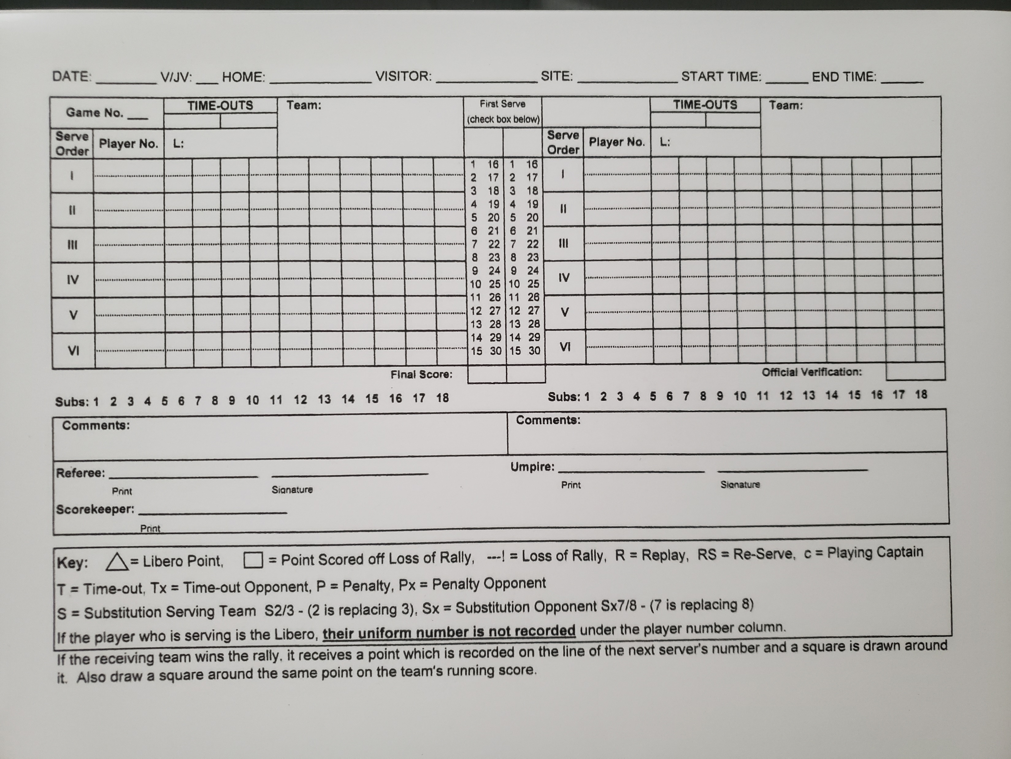

Slide 4
Not all Scoresheets and scorebooks are the same!
The type of scoresheet provided to the scorer may vary from school to school. For instance, some scorebooks may have smaller blocks to enter the events, may not have a comments section, or a place for the referee to initial when verifying the score. Just because it’s not there doesn’t mean you don’t have to worry about it. Improvise to CYA!
Every scoresheet page should have the same basic format and places to put all the information needed, with minimal improvisation necessary.

Slide 5
Scoring requires 100% of your attention!!
Scoring correctly takes concentration. Turn off cell phones and put away any other distractions.
Accurate scoresheets should contain all information the referees need to recreate what happened at any specific point in the set.
Be as quick and efficient as possible. Don’t hesitate to tell the R2 if you need something explained or need more time.
As an R2 remember to be patient with student scorekeepers.
Communicate with your officiating team!

Slide 6
Good Scorekeeping Habits
Don’t stray. Write each event in the order it occurs.
Complete the boxes on the server’s line (points 1,2,3 etc, replay, loss of rally/point to opponent, timeout, substitution, penalty, etc.)
Insert substitute player # next to starting player #, slash the # of subs used, enter timeout scores, if R2 tells you, enter any comments for unusual circumstances.
Serving team - Slash the correct number in the running score column.
If the Libero serves, Draw a triangle around the ROMAN numeral for that serve position. If the Libero scores a point, draw a triangle around the box score and the running score column. If the libero serves out the side-out symbol is also triangled.
If point is due to a loss of rally, draw a box around the point on the server’s line for next server of opponent. Circle if it is a penalty point.

Slide 7
It’s NOT a Guessing Game
Never guess what happened. If you don’t know, ask.
If something out of the ordinary takes place and you don’t understand it, the R2 should take the time to explain it. Make sure you find out what happened and how to record it during the next dead ball.
You are responsible to record each event that occurred in the set correctly on the scoresheet.
The substitutions and Libero serving position on both the scoresheet and Libero tracker sheet should match.
YOUR scoresheet is official, (no matter what is showing on the scoreboard) which is why it has to be accurate. The Libero tracker is also the assistant scorer and should be helping you. The timer can be a third set of eyes.

Slide 8
Be Professional
The scorer is part of the officiating team along with the R1, R2, Libero Tracker (assistant scorer,) Line Judges and Timer. The officials depend on each other to do their jobs efficiently.
The players on both teams deserve the best efforts of the entire officiating team regardless of their skill level.
Please don’t behave like a fan of either team while you are scorer, libero tracker timer or line judge. It can be perceived as bias by the opposition.

Slide 9
NEATNESS COUNTS !
The scoresheet can appear crowded with substitutions and timeouts, especially in a close set.
If you and the R2 can’t read everything easily, the information on the scoresheet can’t be used to sort out any disputes, which you will experience from time to time as both an official and scorer.
Try to be as neat and legible as possible.
Until you are both quick and neat, it is better to take your time and tell the R2 when you are not ready, rather than try to play catch up which may lead to an inaccurate sloppy scoresheet. You cannot continually hold up the pace of the set.
The Libero tracker should be that extra set of eyes and help you.

Slide 10
The Box Scores Always Come First - X (and T) Marks the Spot !
Every event that happens during a player’s term of service is first marked in the box score line for that server, even if it is something the other team does.
An x always indicates action by the non-serving team
Substitutions: S (or Sx for the non-serving team) and the entering / exiting players’ numbers
Timeouts: T (or Tx for the non-serving team)
Penalties: P (or Px for the non-serving team) and the penalized player’s number
Once a player’s term of service ends, a sideways T ( | ) signifies that nothing else should be written on that line until that player or a substitute serves in the next rotation. A box is drawn around the first box for the next server on the receiving teams’ side to signify the point for loss of rally by the serving team.

Slide 11
Think geographically - right and left
The team to your left should be written on the left side of your scoresheet, while the team to your right is written on the right side. When teams substitute, the R2 should say “on the left” or “on the right” If your scoresheet has the teams on the wrong sides of the score sheet, it will be very confusing.
Find out if the teams are switching sides. If not, the scoresheet will remain the same for all subsequent sets.
If teams are switching sides, adjust your scoresheet accordingly for sets 2, 3 and 4. IF the match goes to a deciding set (3rd for MS & JV or 5th) a team may choose the side on they wish to play, so don’t fill out the scoresheet until confirmed. The clock should not start for intermission before the deciding set until serving team and sides are determined.

Slide 12
Volleyball set – Sample scoring
Today’s Varsity match features Ridgemont High School hosting Cooley High School It is October 32, 2022. Match time (not start time) is scheduled for 5:30pm. What time should the officials been on site?
In a perfect world, the scorekeeper will be at the table at least 20-25 minutes before the first set begins. As an official, don’t be surprised if you need to track the work team down during the warmups.

Slide 13
Let’s begin - Basic Information
Write in:
Date of match - October 32, 2022
JV or V?? this is a Varsity match.
Home team is Ridgemont High, Visiting team is Cooley High, and Site is Ridgemont
Game/Set number (Varsity matches are best 3 out of 5 sets. JV matches are best 2 out of 3 sets. This is game/set 1
Teams are allowed 18 total substitutions, so draw a small line between subs 14 & 15. Notify the R2 when a team has used 15,16,17 and 18.
Your sheet should look like this…….

Slide 14
10/32/22
V
Ridgemont
Cooley
Ridgemont
1

Slide 15
Now….
Scorer’s name. Louis Spiccoli (or yours ☺)
Officials’ names MUST ALWAYS be on the scoresheet. Today’s officials are: R1 Ima Fairef and R2 (umpire) Yura Goodone.
By the time the pre-match conference takes place, the teams will have already chosen their sides of the court. Cooley is on your left, Ridgemont is on your right.
Coaches will give the R2 a team roster at the pre-game meeting. The R2 will give this to you after verification. Coaches are allowed changes and additions until 10:00 remains on the clock for pre-match warmup. After that, the roster is official and any changes to the roster will result in a point/loss of rally to that team. R-7-1 Pen2
Tell the R2 if you are not given a roster after the pre-match conference. Rosters are to remain at the score table. R7-1-3

Slide 16
10/32/22
V
Ridgemont
Cooley
Ridgemont
1
COOLEY
RIDGEMONT
Ima Fairef
Yura Goodone
Louis Spiccoli

Slide 17
Lineup tips
If the R2 hasn’t given you the lineup sheet for each team when the clock shows 3:00 remaining in the timed warm-up, tell the R2 IMMEDIATELY.
During intermission, the lineups are due at prior to 1:00 before sets 2, 3, 4 and 5.
If a number appears on the lineup sheet that isn’t on the team roster, tell the R2 IMMEDIATELY!!!
Each lineup should note which player is the floor captain (“c”).
Always double check the lineup.
Compare your scoresheet to the Libero Tracking Sheet to make sure they are the same, with numbers listed in serving order and the captain noted, exactly as on the lineup sheet.

Slide 18
The Missing Libero?? ☹
If a team has not written down a libero number on their lineup sheet, by rule, they will not have a libero for that set.
Be proactive. Ask the R2 to confirm with the coach if this was intended. Often times coaches forget. Most officials allow the change after speaking with the coach.
NO LIBERO LISTED = NO LIBERO. Kudos for catching it beforehand.
The team may add a libero for a subsequent set or change the libero each set– but only if a libero number is properly listed on the lineup sheet for a particular set and is not a duplicate number.

Slide 19
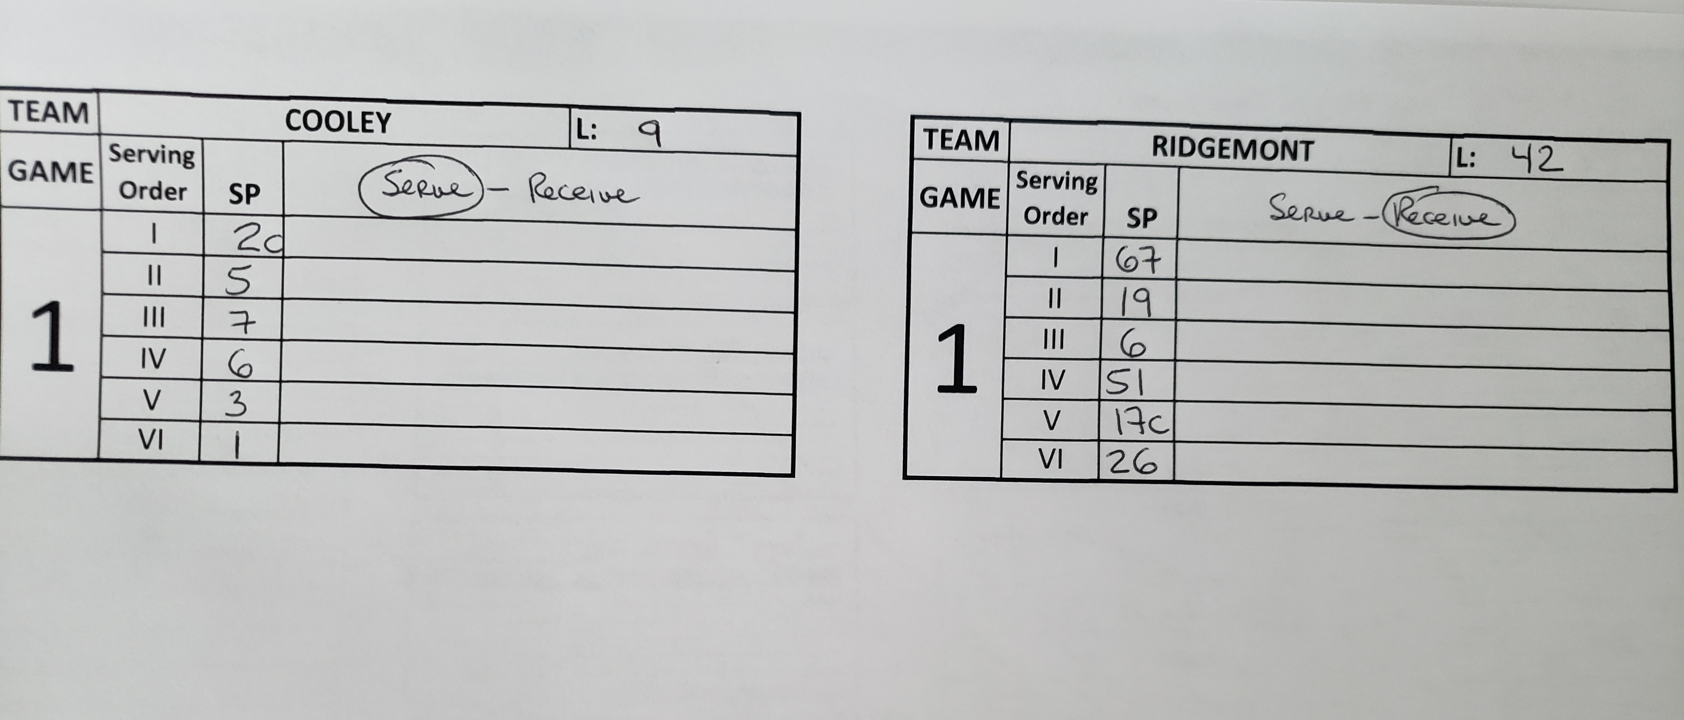
TONIGHT’S LINEUPS
The coin toss resulted in Cooley winning the toss and choosing to serve. Warmups are underway and the rosters turned in and lineups submitted before 2:30 appears on the clock. Enter the lineups as you see them in front of you. Should look like this….

Slide 20
10/32/22
V
Ridgemont
Cooley
Ridgemont
1
COOLEY
RIDGEMONT
9
X
42
2c
67
5
19
7
6
6
51
3
17c
1
26
Ima Fairef
Yura Goodone
Louis Spiccoli

Slide 21
And here we goooooooooooooooooo……..
The set is ready to begin.
Teams have shaken hands, huddled up briefly and have settled into their proper rotations on the court.
Ridgemont #42 replaces #26
The R2 checks the alignments, tosses the ball to Cooley #2, who is in the RB position.
The R1 sounds whistle and signals to serve. The time of day is 5:24pm.
Cooley #2 serves 3 points, then serves into the net.
Ridgemont #26 replaces #42

Slide 22
IS/WAS THAT THE CORRECT SERVER?
Before each serve, check the number of the player on the court serving the ball against the number of the player who is supposed to serve on your scoresheet.
If the numbers don’t match, wait until the serve is contacted, then inform the R2 or inform the R2 when the ball becomes dead. The R2 will then verify who the correct server should have been.

Slide 23
10/32/22
V
Ridgemont
Cooley
Ridgemont
5:24pm
1
COOLEY
RIDGEMONT
9
X
42
3
-I
/
2c
1
2
/
67
1
5
/
19
7
6
6
51
3
17c
1
26
Ima Fairef
Yura Goodone
Louis Spiccoli

Slide 24
Ridgemont #67 serves 4 points, then Ridgemont loses the rally.
Cooley substitutes #4 for #3 and #10 for #1
Ridgemont’s #42 replaces #19, and serves 3 points and Ridgemont loses the rally
Ridgemont substitutes #2 for #51
Cooley #7 serves 5 points
Ridgemont calls a timeout
Cooley #7 serves into the net

Slide 25
10/32/22
V
Ridgemont
Cooley
Ridgemont
5:24pm
1
COOLEY
9-15
RIDGEMONT
9
X
42
4
3
/
3
2c
1
2
-I
/
67
1
2
5
/
6
9
7
9
5
4
5
6
7
8
19
8
S10/1
S4/3
7
10
12
14
15
6
10
11
13
TX
Sx2/51
51
6
,2
,4
17c
3
,10
26
1
Ima Fairef
Yura Goodone
Louis Spiccoli

Slide 26
Ridgemont #6 serves 2 points
On the 3rd serve attempt #6 tosses the ball into the air and lets it fall to the floor for a reserve.
#6 then serves 2 more points, and Cooley head coach requests a time out
After the time out #6 again tosses the ball into the air and lets it fall to the floor. R1 whistles and signals point/loss of rally.
#6 is visibly upset and calls R1 a “no talent jerkoff” The R1 determines this is a serious offense and issues Ridgemont #6 a red conduct card. A penalty point is assessed to Cooley

Slide 27
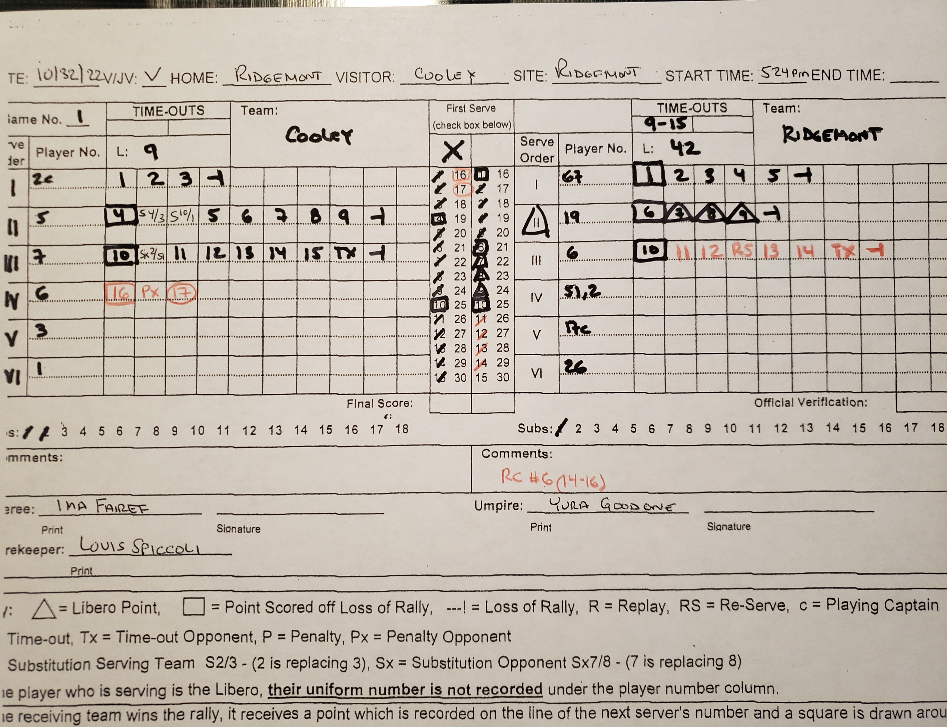
15-14
,4
,10

Slide 28
Note: A player is allowed ONE re-serve during that player’s term of service. Should a team sub for the current server, the sub is also allowed ONE re-serve. Proper scorekeeping will alleviate any issues that may arise. R2’s make sure the scorer properly records a re-serve RS, especially after a long scoring streak where a time out may be used. It can easily be forgotten by the referees.
Brief discussion:
As an official, what do you do when a re-serve is granted for the server?

Slide 29
Cooley #6 serves out
Ridgemont #2 serves 2 points and Ridgemont loses the rally.
Cooley #4 serves 2 points and Cooley loses the rally.
Ridgemont #19 replaces #42…..#17 serves 2 points and Ridgemont loses the rally.
Cooley substitutes #1 for #10
Cooley #1 serves out.
Ridgemont #26 serves out.. STOP - Before you record the 22nd point in the next service box for Cooley………

Slide 30
We have now reached the end of the first service rotation as all 6 positions on each team have served. Cooley #2 will be the next server. You will need to change colors when starting a second (and subsequent) rotation when you record the Ridgemont loss of rally/ point in the Cooley #2 service box. We’ll change to green.

Slide 31
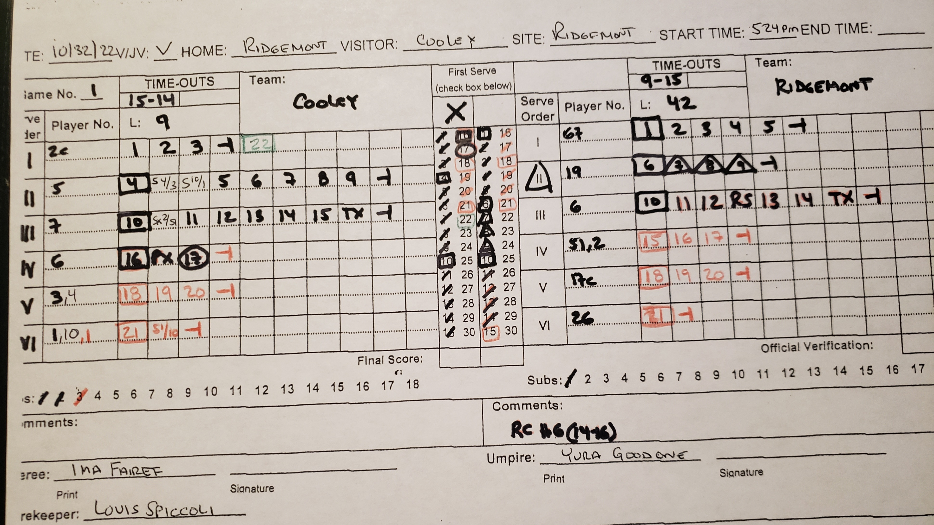

Slide 32
Cooley #2 serves 1 point.
#10 steps into the substitution zone, R2 sounds whistle and signals. There is no movement and Cooley coach says, “not now” and #10 leaves the zone. R2 shows R1 a yellow card for unnecessary delay sub withdrawn. R1 shows yellow for unnecessary delay.
a
Cooley #2 serves 1 point.
At this point with the score 24-21, as scorer, you need to alert the R2 of the set point on your left.
Cooley #2 serves and Cooley loses the rally.
Ridgemont #67 serves and Ridgemont loses the rally.
The set is over.. Final score Cooley 25 Ridgemont 22.. It is 5:48pm
R2 should verify your scoresheet and initial the OFFICIAL VERIFICATION

Slide 33
Your completed scoresheet should look like this..

Slide 34
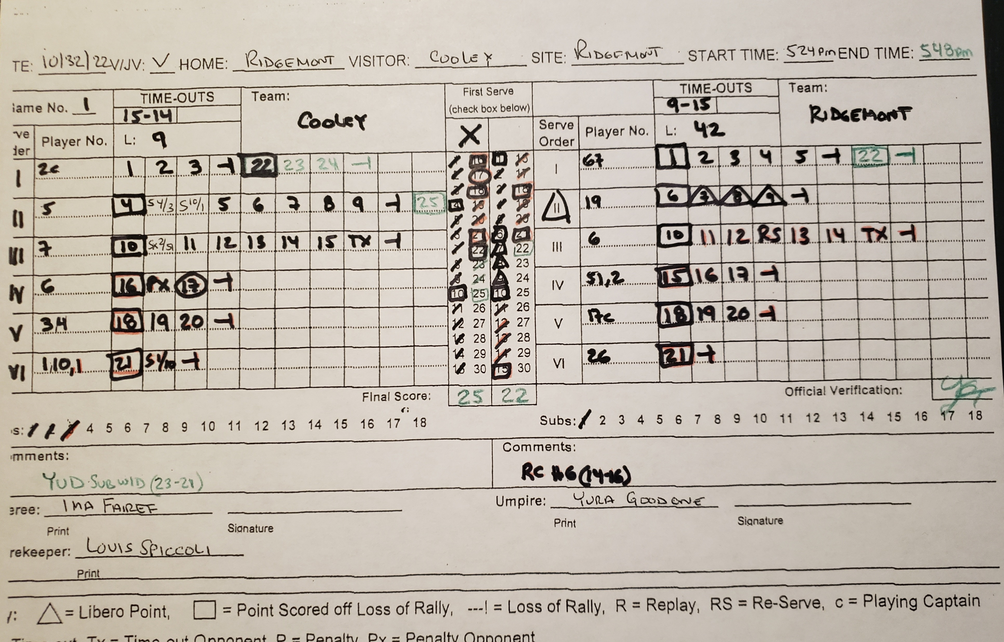

Slide 35
Does your LIBERO TRACKING SHEET look like this?
TEAM | COOLEY |  |  | L: 9 |  | TEAM | RIDGEMONT |  |  | L: 42
GAME | Serving Order | SP |  |  |  | GAME | Serving Order | SP
1 | I | 2c |  |  |  | 1 | I | 67
 | II | 5 |  |  |  |  | II | 19 | L 19
 | III | 7 |  |  |  |  | III | 6
 | IV | 6 |  |  |  |  | IV | 51 | 2
 | V | 3 | 4 |  |  |  | V | 17c
 |  |  |  |  |  |  | VI | 26 | L 26
 | VI | 1 | 10 1 |  |  |  | VI | 26 | L 26

Slide 36
Finals comments about this scoring module:
Make sure you remind the R2 to verify and initial the scoresheet after each set.
It is not necessary to have both officials sign the scoresheet, but both names should be somewhere ON it. Most of the scoring will be done in a book. You may have to improvise a bit for official’s names, comments (if any) and possibly a space R2 can verify/initial the final score.
We covered some fairly basic events that happen in a volleyball match. In most cases both Liberos will probably serve and there may be a lot more than 4 substitutions. The red card was a bit extreme for a beginning course, but it showed how to properly record that event and the penalty point associated with it. Yellow cards for unnecessary delays happen on many occasions.

Slide 37
Going forward, REMEMBER THIS…
Make sure player numbers on the rosters and lineups match.
In pencil, write the lineups in as soon as you get them. A coach may make a change after it’s submitted, most likely due to injury or illness. Using a pencil allows you to easily erase and correct any changes or mistakes.
Draw a little line between subs 14 and 15 as a reminder to let R2 know when a team has used its 15th 16th 17th and 18th substitution.
Make sure you record every substitution. Once you see who is subbing for who it will be easier. Rarely do teams use a 3-person rotation so pay attention and make sure the correct players are subbing in/out.
Don’t forget to change colors at the start of each new service rotation.
Practice, practice, practice! Download some blank score sheets and if you are the R2 for an IAAMS or Baltimore City match, get there early, sit with the scorer and score the match. If done correctly an official should be able to tell you everything that happened during the set in the exact order it happened.
Don’t hesitate to reach out if you have any questions. We are here to help you be successful in all the potential duties you may have as a game official.

Slide 38
Officials, you should ALWAYS have extra score sheets, roster/lineup sheets and libero tracking sheets with you just in case. Go to our website www.bbows.org volleyball tab, then select Game Specific Forms to download and print copies. One day you WILL need them and you’ll thank me for it.
QUESTIONS????

